Slide 1
Agentic RAG Chatbot using MCP (Ollama Edition)
Private Local Chatbot for File Question Answering
LLM + VectorDB + Agent Framework

Slide 2
Architecture Overview
- Streamlit UI for user interaction
- Ollama for local LLM (LLaMA3)
- FAISS for vector DB
- Sentence Transformers for Embedding
- Agentic Flow using Model Context Protocol (MCP)

Slide 3
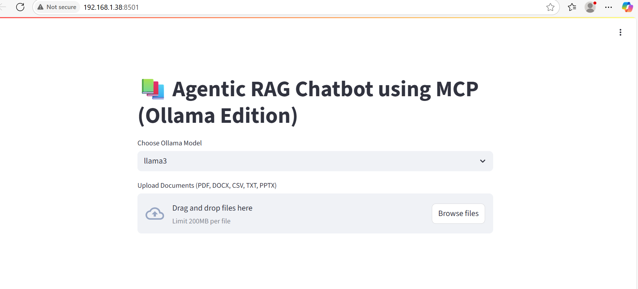
App Interface - Upload Document

Slide 4
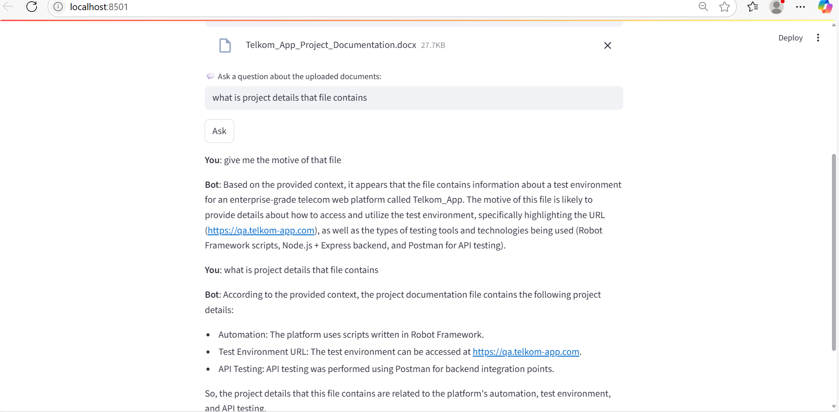
App Interface - Ask Questions

Slide 5
Agentic Flow via MCP
- UI sends document and query
- IngestionAgent parses and embeds text
- RetrievalAgent finds top matching chunks
- LLMResponseAgent generates answer using context and LLM

Slide 6
Summary and Benefits
- Offline chatbot for PDFs, DOCX, CSV, PPTX, TXT
- Local LLM with Ollama ensures data privacy
- Modular agent system enables easy extension
- Fast setup with Streamlit and MCP agents

